Slide 1


Limit Order Processing Project
Group members:
Josselin Masse, Saad Handar

Slide 2

I. Project management
II. Project architecture
III. Functions & classes
IV. Output

Slide 3
I. Project management
III. Functions & classes
II. Project architecture
IV. Output
V. Demo
Steps
Details
1
Architecture of the Project
Defining the project architecture
Designing the functions and classes
Sharing the tasks and defining each member part
2
Executing the code
Executing the code in coordination with group members on some details
3
Preparing the folder and presentation
Finalising the code + testing
Preparing the presentation

Slide 4
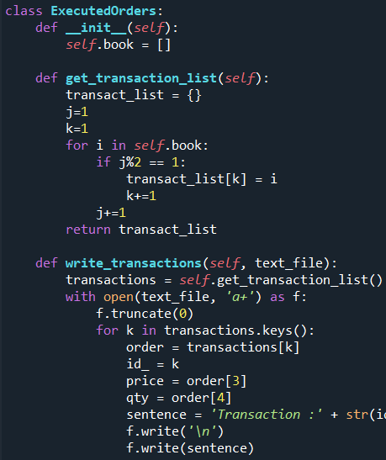
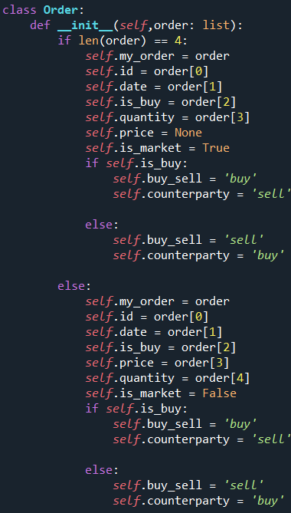
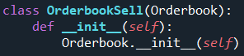
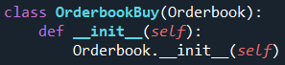
I. Project management
III. Functions & classes
II. Project architecture
IV. Output
V. Demo
1. Classes
Parent Class
Class
Class
Class Orderbook
Class Executedorders
Class Order
Child Class
Child Class
Class Orderbooksell
Class Orderbookbuy

Slide 5
I. Project management
III. Functions & classes
II. Project architecture
IV. Output
V. Demo
2. Functions Architecture
Generate_Order
Process_Market_Order
Execute
Main
Process_orders
Process_Limit_Order
Order book

Slide 6
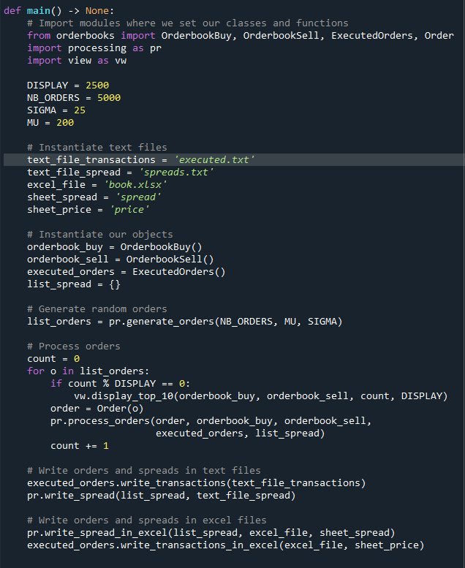
I. Project management
III. Functions & classes
II. Project architecture
IV. Output
V. Demo
Function details :
Main

Slide 7
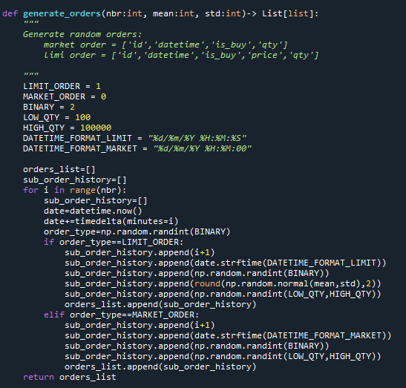
I. Project management
III. Functions & classes
II. Project architecture
IV. Output
V. Demo
Function details:
Generate Orders

Slide 8
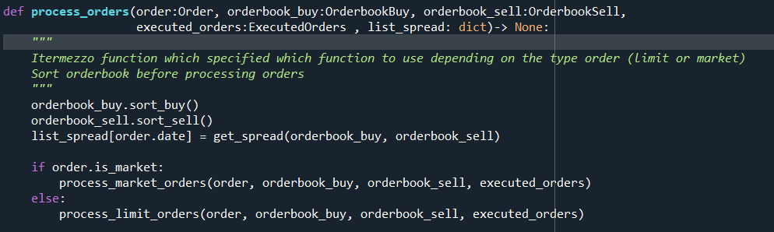
I. Project management
III. Functions & classes
IV. Output
V. Demo
II. Project architecture
Function details:
Process orders

Slide 9
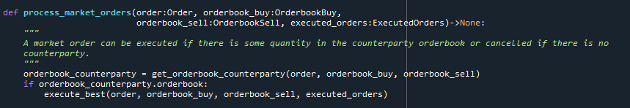
I. Project management
III. Functions & classes
IV. Output
V. Demo
II. Project architecture
Function details:
Process market orders

Slide 10
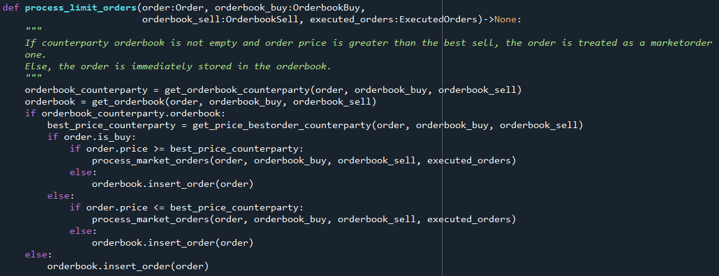
I. Project management
III. Functions & classes
II. Project architecture
IV. Output
V. Demo
Function details:
Process limit order

Slide 11
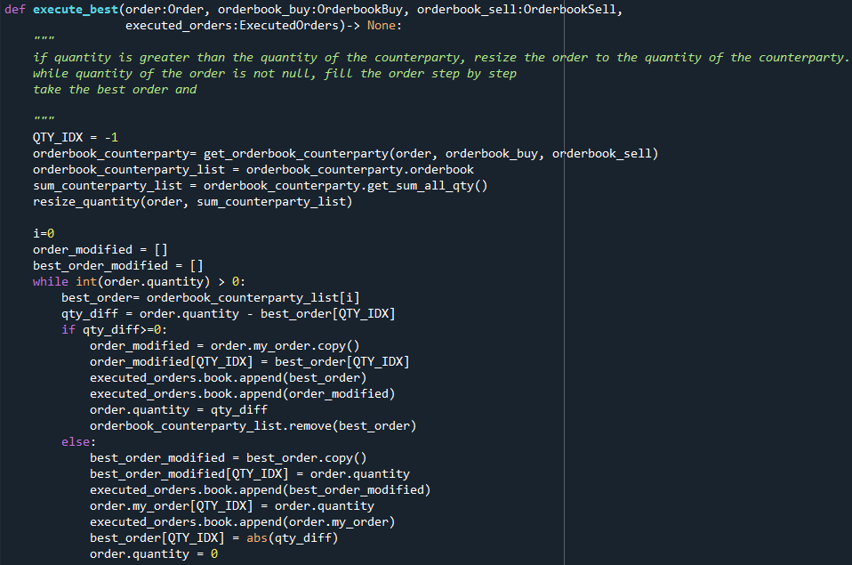
I. Project management
III. Functions & classes
II. Project architecture
IV. Output
V. Demo
Function details:
Execute

Slide 12
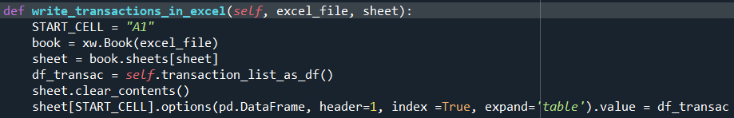
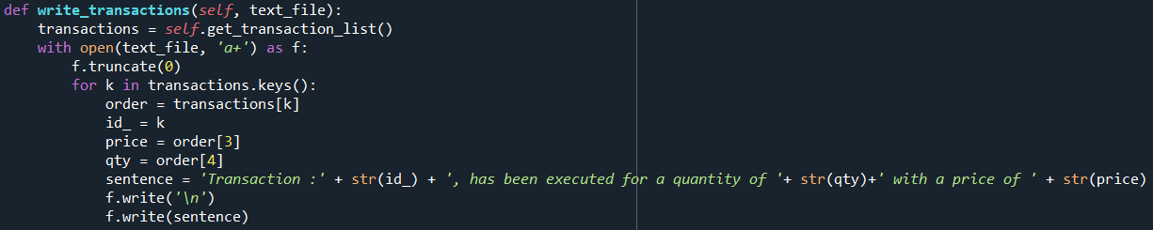
I. Project management
III. Functions & classes
II. Project architecture
IV. Output
V. Demo
Function details:
Display functions

Slide 13
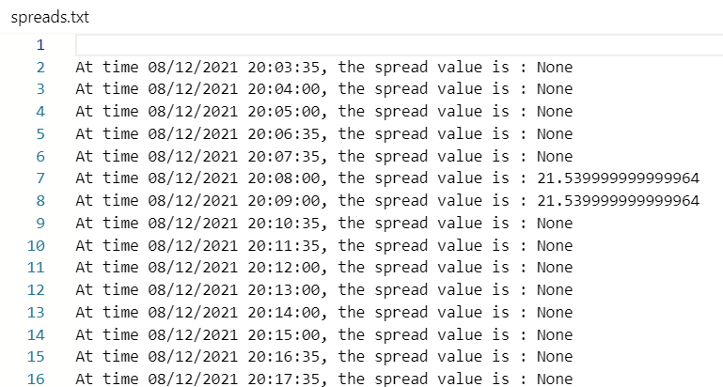
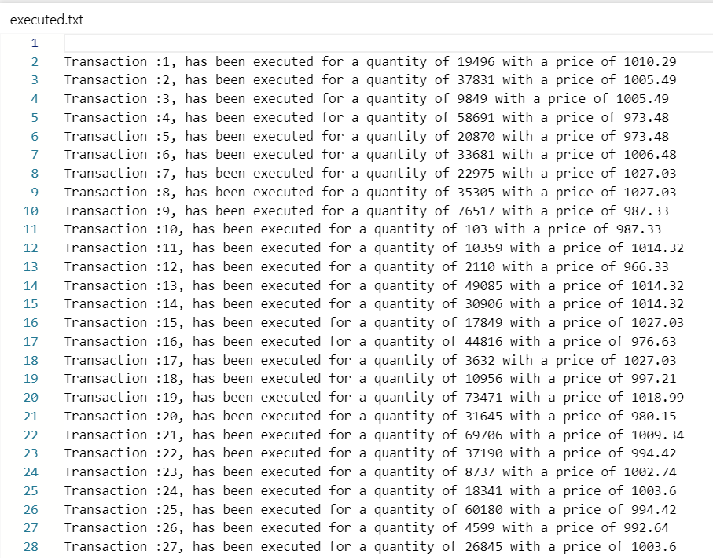
I. Project management
III. Functions & classes
II. Project architecture
IV. Output
V. Demo
Spread.txt
Executed.txt

Slide 14
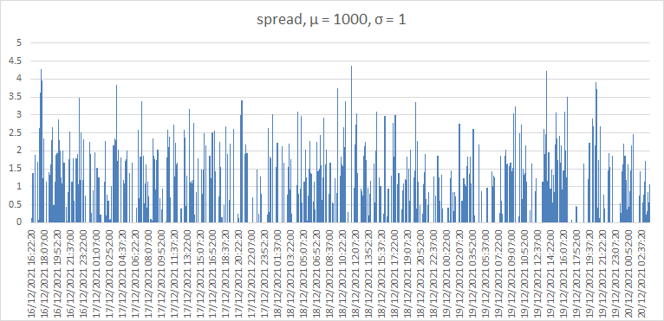
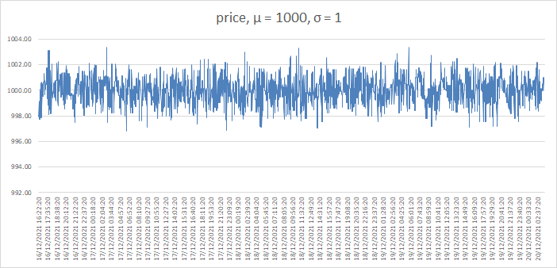
I. Project management
III. Functions & classes
II. Project architecture
IV. Output
V. Demo
Excel Spread sheet

Slide 15
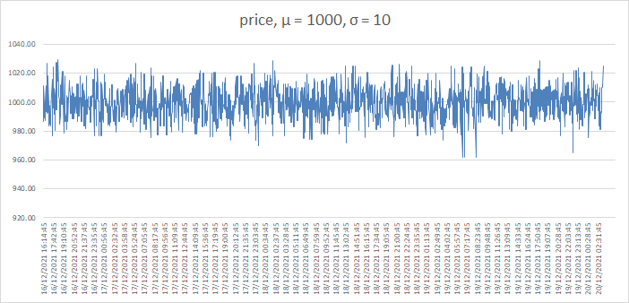
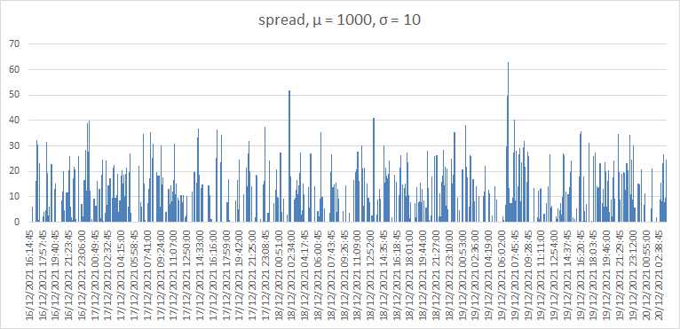
I. Project management
III. Functions & classes
II. Project architecture
IV. Output
V. Demo
Excel Spread sheet

Slide 16
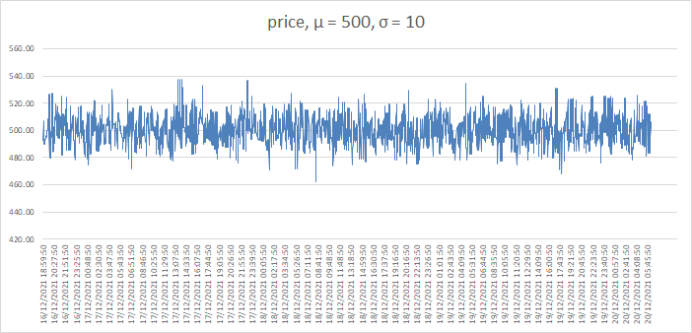
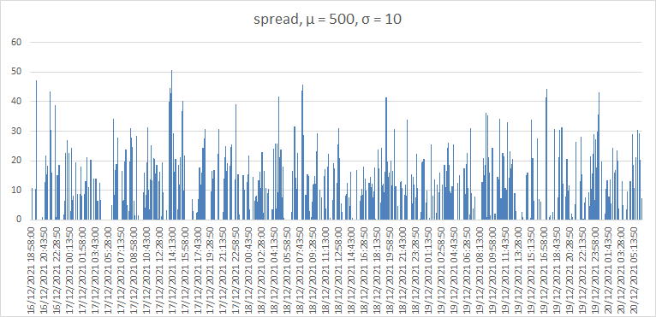
I. Project management
III. Functions & classes
II. Project architecture
IV. Output
V. Demo
Excel Spread sheet

Slide 17
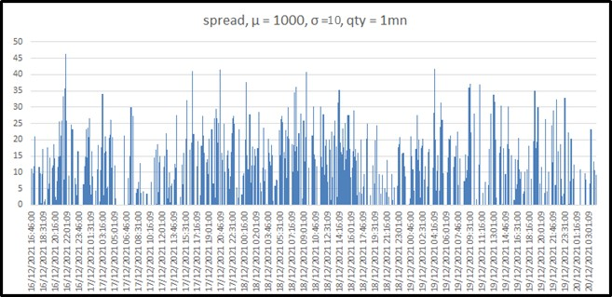
I. Project management
III. Functions & classes
II. Project architecture
IV. Output
V. Demo
Excel Spread sheet :

Slide 18
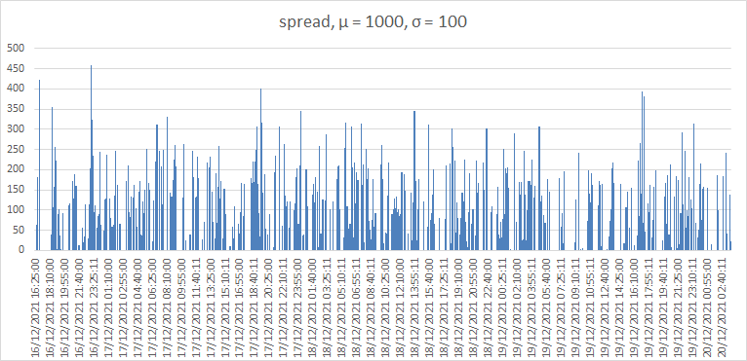
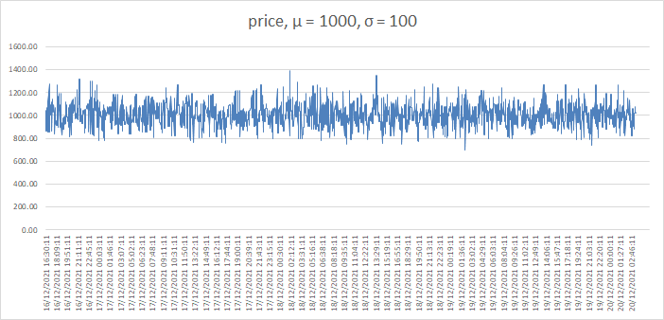
I. Project management
III. Functions & classes
II. Project architecture
IV. Output
V. Demo
Excel Spread sheet :

Slide 19
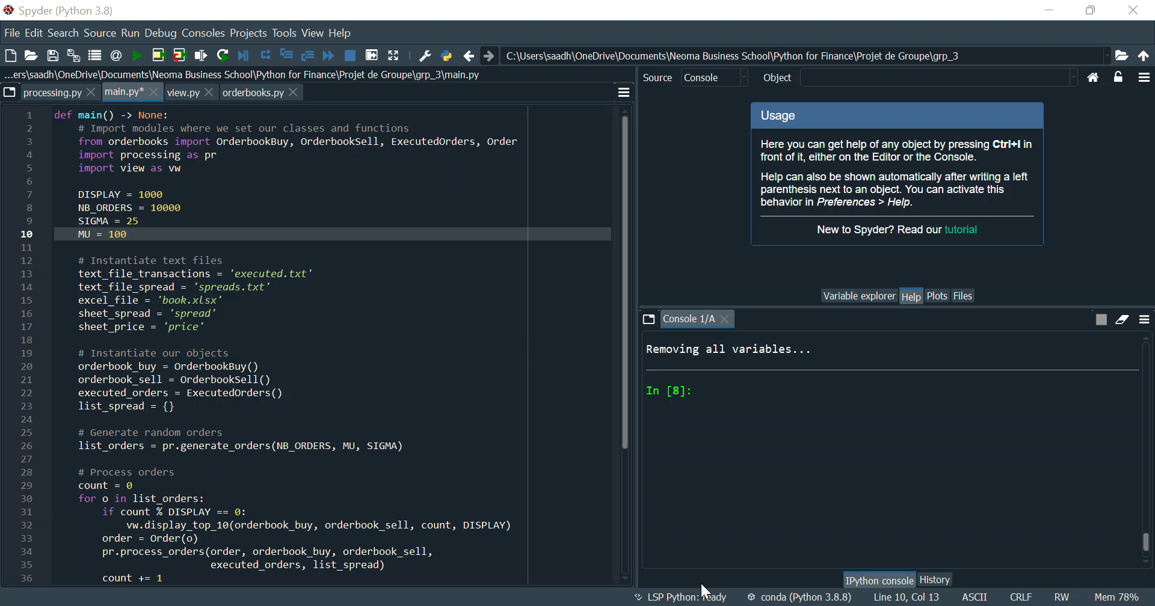
I. Project management
III. Functions & classes
II. Project architecture
IV. Output
V. Demo

Slide 20

Thank you for your attention

